Slide 1
Classification Algorithms
Naïve Bayes
Prof. H.P.Channe

Slide 2
Probability Terminologies
An experiment is a situation involving chance or probability that leads to results called outcomes.
Experiment: A coin is tossed, will get Head or Tail.
An event is one or more outcomes of an experiment.
Outcome – Result of a single trial.
Probability- Likelihood of an event.
Example- 60% chance of it will rain today.
Probability of raining = 0.6
Sample Space: The set of all possible outcomes of an event is called the sample space.
Example: For dice s1 = {1,2,3,4,5,6}, For tossing a coin s2 = {H,T}
Random variable: Takes random values with each value having some probability.
Exhaustive Events: A set of events are said to be exhaustive if at least one of the events must occur at any time.
A U B = S

Slide 3
Terminologies
Independent Event: Occurrence of one event does not have any effect on occurrence of another, then the two events are said to be independent.
P (A ∩ B) = P(AB) = P(A) * P(B)
Example: Choosing a 3 from a deck of cards, replacing it, AND then choosing an ace as the second card.

Slide 4
Conditional Probability
Coin Toss and Fair Dice Example
Example 1: When you flip a fair coin, there is an equal chance of getting either heads or tails.
P(H) = 50%.
Example 2: The probability of getting a 1 when you roll a dice with 6 faces?
Assuming the dice is fair, the probability of 1/6 = 0.166.
Example 3: X ={1,2,3,4,5,6}, Occurrence of even number = 3/6 = 0.5
Example 4: Sums of pair of dice, X = {2,3,4,5,6,7,8,9,10,11,12}
Probability of getting sum =6, will get sum of 6, 5 times, total sample space = 36
Probability of getting sum(6) = 5/36
Playing Cards Example
If you pick a card from the deck, can you guess the probability of getting a queen given the card is a spade?
Condition is the card is a spade.
So, the denominator (eligible population) is 13 and not 52.
And since there is only one queen in spades, the probability it is a queen given the card is a spade is 1/13 = 0.077

Slide 5
Conditional Probability
Solution: This is conditional probability.
Let A denote the event for which the two faces sums to 10, and B the event for which the first throw equals 5.
Then the sample space for A= { (5,5),(4,6),(6,4) }.
The sample space for B = { (5,1),(5,2),(5,3),(5,4),(5,5),(5,6) }.
Therefore, A∩B={5,5}
P(B|A) = P(A∩B)/P(A)
P(A∩B) = 1/36 , P(A) = 3/36
P(B|A) = 1/36 over 3/36 = 1/3
So, when we say the conditional probability of A given B, it denotes the probability of A occurring given that B has already occurred.
Mathematically, Conditional probability of A given B can be computed as:
P(A|B) = P(A AND B) / P(B)
Example: Two standard dice with 6 sides are thrown and the faces are recorded. Given that the sum of the two faces equals to 10, what is the probability that the first throw equals to 5?

Slide 6
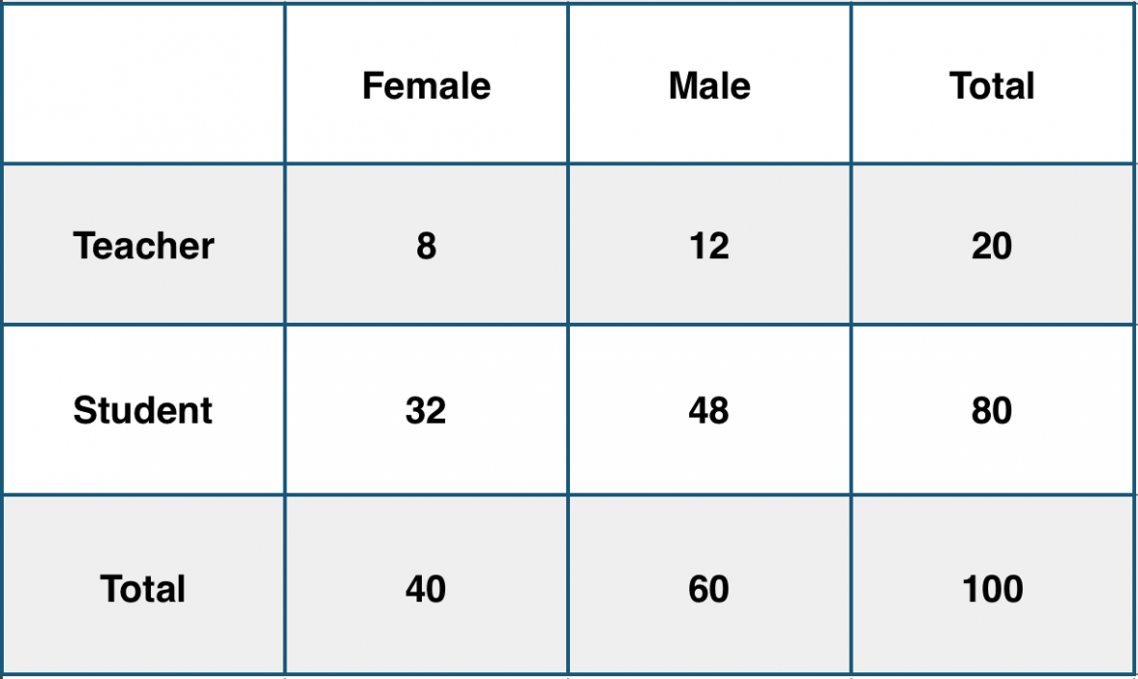
Conditional Probability Example
School Example
Consider a school with a total population of 100 persons. These 100 persons can be seen either as ‘Students’ and ‘Teachers’ or as a population of ‘Males’ and ‘Females’.
With the tabulation of the 100 people, what is the conditional probability that a certain member of the school is a ‘Teacher’ given that he is a ‘Man’?

Slide 7
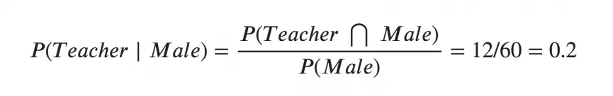
Example
To calculate this, you may intuitively filter the sub-population of 60 males and focus on the 12 (male) teachers.
So the required conditional probability P(Teacher | Male) = 12 / 60 = 0.2.
Mathematically, Conditional probability of A given B can be computed as:
P(A|B) = P(A AND B) / P(B)
A : Teacher
B: Male (Condition)

Slide 8
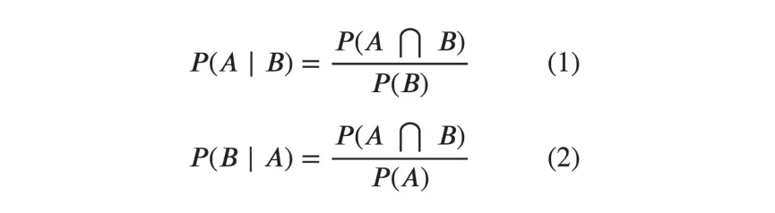
Bayes Rule
Likewise, the conditional probability of B given A can be computed.
The Bayes Rule that we use for Naive Bayes, can be derived from these two notations.

Slide 9
The Bayes Rule
The Bayes Rule is a way of going from P(X|Y), known from the training dataset, to find P(Y|X).
To do this, we replace A and B in the above formula, with the feature X and response Y.
For observations in test or scoring data, the X would be known while Y is unknown.
And for each row of the test dataset, you want to compute the probability of Y given the X has already happened.
P(X|Y) = P(X ∩ Y) / P(Y)
P(Y|X) = P(Y ∩ X) / P(X)

Slide 10
The Naive Bayes
The Bayes Rule provides the formula for the probability of Y given X. But, in real-world problems, you typically have multiple X variables.
When the features are independent, we can extend the Bayes Rule to what is called Naive Bayes.
It is called ‘Naive’ because of the naive assumption that the X’s are independent of each other. Regardless of its name, it’s a powerful formula.

Slide 11
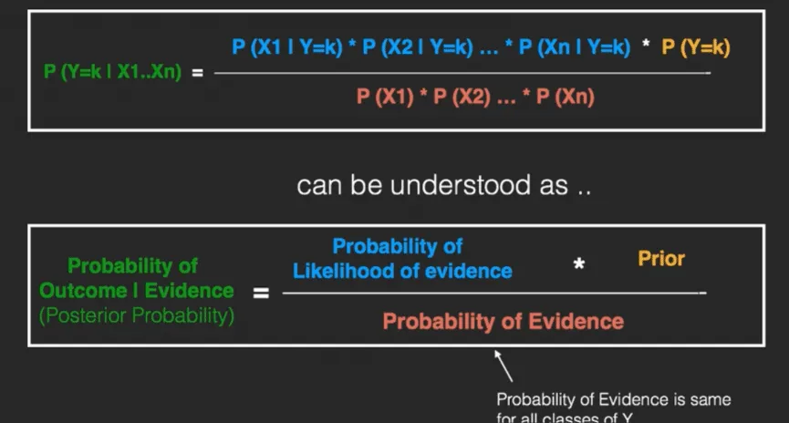
Naive Bayes
The left-hand-side (LHS) of the equation is understood as the posterior probability or simply the posterior.
The RHS has 2 terms in the numerator.
The first term is called the ‘Likelihood of Evidence’. It is nothing but the conditional probability of each X’s given Y is of particular class ‘c’.
Since all the X’s are assumed to be independent of each other, you can just multiply the ‘likelihoods’ of all the X’s and called it the ‘Probability of likelihood of evidence’.
This is known from the training dataset by filtering records where Y=c.
The second term is called the prior which is the overall probability of Y=c, where c is a class of Y.
In simpler terms:
Prior = count (Y=c) / n_Records.
Likelihood of Evidence
Figure source www.machinelearningplus.com

Slide 12
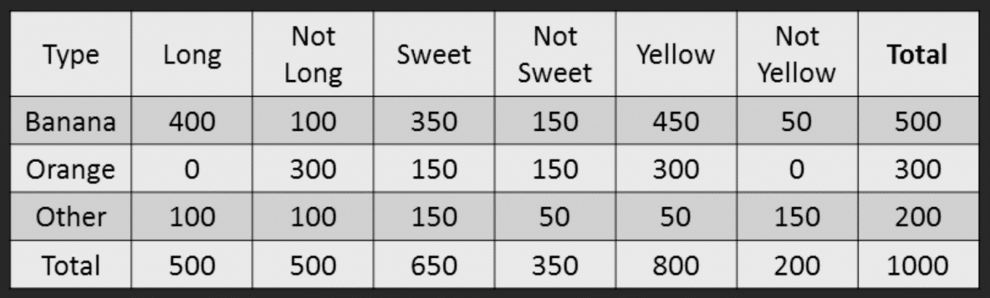
Naive Bayes Example by Hand
Say you have 1000 fruits which could be either ‘banana’, ‘orange’ or ‘other’. These are the 3 possible classes of the Y variable.
We have data for the following X variables, all of which are binary (1 or 0).
Long
Sweet
Yellow
Fruit | Long (x1) | Sweet (x2) | Yellow (x3)
Orange | 0 | 1 | 0
Banana | 1 | 0 | 1
Banana | 1 | 1 | 1
Other | 1 | 1 | 0

Slide 13
Naive Bayes Classifier
The objective of the classifier is to predict if a given fruit is a ‘Banana’ or ‘Orange’ or ‘Other’ when only the 3 features (long, sweet and yellow) are known.
Let’s say you are given a fruit that is: Long, Sweet and Yellow, can you predict what fruit it is?
This is the same of predicting the Y when only the X variables in testing data are known. Let’s solve it by hand using Naive Bayes.
The idea is to compute the 3 probabilities, that is the probability of the fruit being a banana, orange or other. Whichever fruit type gets the highest probability wins.
All the information to calculate these probabilities is present in the above tabulation.

Slide 14
Naive Bayes Classification
Step 1: Compute the ‘Prior’ probabilities for each of the class of fruits.
That is, the proportion of each fruit class out of all the fruits from the population. You can provide the ‘Priors’ from prior information about the population. Otherwise, it can be computed from the training data.
For this case, let’s compute from the training data. Out of 1000 records in training data, you have 500 Bananas, 300 Oranges and 200 Others. So the respective priors are 0.5, 0.3 and 0.2.
P(Y=Banana) = 500 / 1000 = 0.50
P(Y=Orange) = 300 / 1000 = 0.30
P(Y=Other) = 200 / 1000 = 0.20

Slide 15
Naive Bayes Classification
Step 2: Compute the probability of evidence that goes in the denominator.
This is nothing but the product of P of Xs for all X. This is an optional step because the denominator is the same for all the classes and so will not affect the probabilities.
P(x1=Long) = 500 / 1000 = 0.50
P(x2=Sweet) = 650 / 1000 = 0.65
P(x3=Yellow) = 800 / 1000 = 0.80

Slide 16
Naive Bayes Classification
Step 3: Compute the probability of likelihood of evidences that goes in the numerator.
It is the product of conditional probabilities of the 3 features.The formula, it says P(X1 | Y=k).
Here X1 is ‘Long’ and k is ‘Banana’.
That means the probability the fruit is ‘Long’ given that it is a Banana.
In the above table, you have 500 Bananas.
Out of that 400 is long. So, P(Long | Banana) = 400/500 = 0.8.
Probability of Likelihood for Banana
P(x1=Long | Y=Banana) = 400 / 500 = 0.80
P(x2=Sweet | Y=Banana) = 350 / 500 = 0.70
P(x3=Yellow | Y=Banana) = 450 / 500 = 0.90
So, the overall probability of Likelihood of evidence for Banana = 0.8 * 0.7 * 0.9 = 0.504

Slide 17
Naive Bayes Classification
Step 3: Compute the probability of likelihood of evidences that goes in the numerator.
It is the product of conditional probabilities of the 3 features.The formula, it says P(X1 | Y=k).
Probability of likelihood for Orange
In the above table, you have 300 Oranges.
Probability of Likelihood for Orange
P(x1=Long | Y=Orange) = 0 / 300 = 0
P(x2=Sweet | Y=Orange) = 150 / 300 = 0.50
P(x3=Yellow | Y=Orange) = 300 / 300 = 1
So, the overall probability of Likelihood of evidence for Banana = 0 * 0.5 * 1 = 0

Slide 18
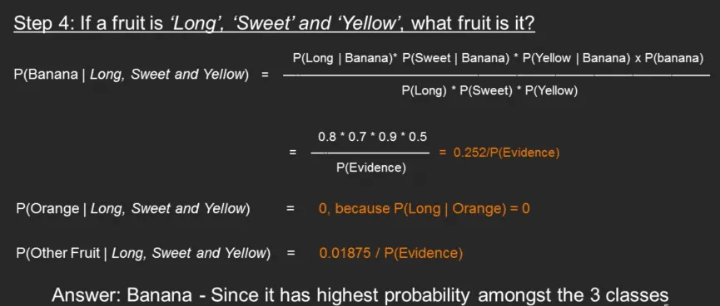
Naive Bayes Classification
Step 4: Substitute all the 3 equations into the Naive Bayes formula, to get the probability that it is a banana.
Similarly, you can compute the probabilities for ‘Orange’ and ‘Other fruit’. The denominator is the same for all 3 cases, so it’s optional to compute.
Clearly, Banana gets the highest probability, so that will be our predicted class.

Slide 19
Types of Naive Bayes
1. Gaussian Naive Bayes
2. Multinomial Naive Bayes
3. Bernouli Naive Bayes
1. Gaussian Naive Bayes
When to use:
When variables are continuous.
Assumes normal distribution of variables

Slide 20
Types of Naive Bayes
1. Gaussian Naive Bayes
2. Multinomial Naive Bayes
3. Bernouli Naive Bayes
2. Multinomial Naive Bayes
When to use:
When the features represents frequency.
Ignores non-occurrence of features.

Slide 21
Types of Naive Bayes
1. Gaussian Naive Bayes
2. Multinomial Naive Bayes
3. Bernouli Naive Bayes
3. Bernouli Naive Bayes
When to use:
When features are binary
Penalize non-occurrence of a feature.

Slide 22
Applications of Naive Bayes
There are 4 main applications:
1. Real-time prediction:
Easy and fast. So used for making predictions in real time.
2. Multi-class Prediction:
3. Text Classification/Spam filtering/Sentiment Analysis:
4.Recommendation System:
NB and collaborative filtering together builds a recommendation system that uses ML and data mining techniques to filter unseen information and predict whether a user would like a given resource or not.

Slide 23
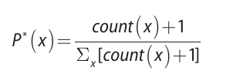

Smoothing
Laplace Correction:
The value of P(Orange | Long, Sweet and Yellow) was zero in the above example, because, P(Long | Orange) was zero. That is, there were no ‘Long’ oranges in the training data.
It makes sense, but when you have a model with many features, the entire probability will become zero because one of the feature’s value was zero. To avoid this, we increase the count of the variable with zero to a small value (usually 1) in the numerator, so that the overall probability doesn’t become zero.
This correction is called ‘Laplace Correction’. Most Naive Bayes model implementations accept this or an equivalent form of correction as a parameter.
One problem of the Laplace smoothing is that it may assign too much probability to unseen events. To address this problem, Laplace smoothing can be generalized to use ε instead of 1, where typically ε ∈[ 0 , 1. ]

Slide 24

Gaussian Naive Bayes
But how to compute the probabilities when X is a continuous variable?
If we assume that the X follows a particular distribution, then you can plug in the probability density function of that distribution to compute the probability of likelihoods.
If you assume the X’s follow a Normal (Gaussian) Distribution, which is fairly common, we substitute the corresponding probability density of a Normal distribution and call it the Gaussian Naive Bayes.
You need just the mean and variance of the X to compute this formula.
Where mu and sigma are the mean and variance
of the continuous X computed for a given class
‘c’ (of Y).
To make the features more Gaussian like, you might
consider transforming the variable using something
like the Box-Cox to achieve this.

Slide 25
Advantages
The Naive Bayes classifier in many cases is competitive with other learning algorithms, including decision trees and neural networks.
Naive Bayes performs better than decision trees on categorical data with many levels.
More resistant to overfitting than decision trees with the presence of a smoothing techniques.
Decision trees can handle categorical values but too many levels may result in a deep tree.
Easier to build and understand.
Faster than other algorithms.
Easily scalable.
Popular choice for text classification problems.
Naïve Bayes classifiers can handle missing values.
Naïve Bayes is also robust to irrelevant variables-variables that are distributed among all the classes whose effects are not pronounced.
The model is simple to implement even without using libraries.
The prediction is based on counting the occurrences of events, making the classifier efficient to run.
Naïve Bayes is computationally efficient and is able to handle high-dimensional data efficiently.

Slide 26
Disadvantages
If a categorical variable has a category (in the test data set), which was not observed in the training dataset, then model will assign 0 probability and will be unable to make a prediction.
This is known as ‘zero frequency’.
To solve this we can use the smoothing technique. e.g. Laplace estimation.
Naive Bayes is also known as bad estimator, so the probability outputs from predict_proba are not to be taken too seriously.
Another limitation of Naive Bayes is the assumption of independent predictors. In real life, it is almost impossible that we get a set of predictors which are completely independent.
It is sensitive to correlated variables because the algorithm may double count the effects.
As an example, assume that people with low income and low credit tend to default. If the task is to score “default” based on both income and credit as two separate attributes, naïve Bayes would experience the double-counting effect on the default outcome, thus reducing the accuracy of the prediction.
Probabilities are provided as part of the output for the prediction, naïve Bayes classifiers in general are not very reliable for probability estimation and should be used only for assigning class labels.
Naïve Bayes in its simple form is used only with categorical variables.
Any continuous variables should be converted into a categorical variable with the process known as discretization.
Low Income: income < $10,000
Working Class: $10,000 ≤ income < $50,000
Middle Class: $50,000 ≤ income < $1,000,000
Upper Class: income ≥ $1,000,000

Slide 27
Tips to improve the Model
Try transforming the variables using transformations like BoxCox or YeoJohnson to make the features near Normal.
Try applying Laplace correction to handle records with zeros values in X variables.
Check for correlated features and try removing the highly correlated ones. Naive Bayes is based on the assumption that the features are independent.
Feature engineering. Combining features (a product) to form new ones that makes intuitive sense might help.
Try providing more realistic prior probabilities to the algorithm based on knowledge from business, instead of letting the algo calculate the priors based on the training sample.

Slide 28
References
www.machinelearningplus.com

